Slide 1



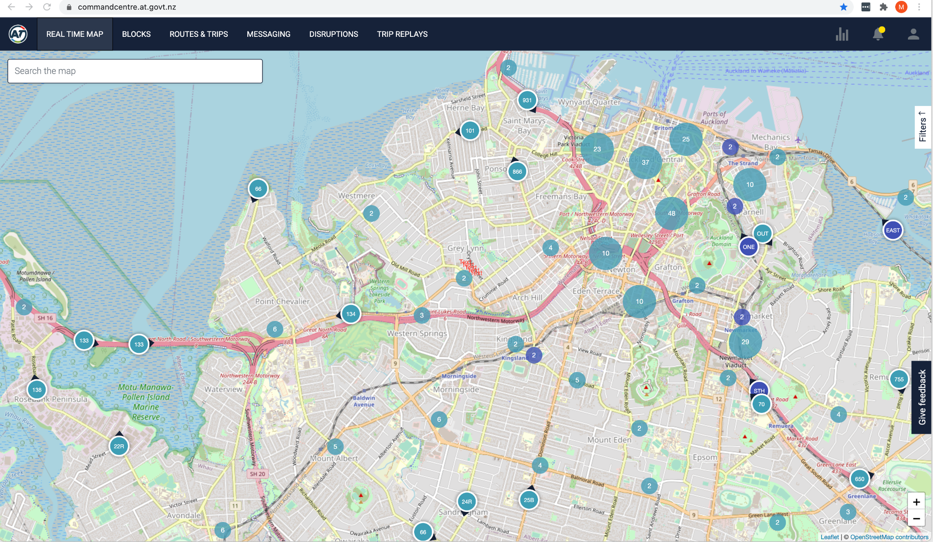





Data Source
Option 1 allows us to use a Kafka connector to have direct access to the data on Kafka Topics – as a first phase this will give AT access to Realtime data
Microsoft Power BI with live Apache Kafka data for up-to-date visual analysis and reporting.
Real-Time Data Access (DirectQuery)
Full Metadata Discovery
Robust SQL-92 Support
Will work for the majority of our RealTime data but not all
Apparently (I have not yet verified this) Microsoft is working on making the delay between the connector and PBI quicker ? - Anton can give you more details ☺
Azure
Real-time Data
Stream Processing
API
GIS
Streaming
Streaming
Streaming
Streaming
Kafka PBI Connector
Replication
Query
Reporting
15 min - slight delay
Real-time Data
Long Term Storage
Query
Micro Batch
On Premise
Documentation: Kafka Power BI Connector

Slide 2

Data Source
Azure
Real-time Data
Stream Processing
API
GIS
Option 2 allows us to use a Kafka KSQL as a temporary storage to give AT access to Realtime data – the duration of the temporary storage can be determined by the business
More expensive solution
They offer a higher-productivity interface for working with Kafka without diluting its core concepts.
Check out the animation - How Realtime streaming works - KSQL
Streaming
Streaming
Streaming
Streaming
Confluent Platform ksqlDB (temp Storage)
Replication
Query
Reporting
Direct query
Real-time Data
Long Term Storage
Query
Micro Batch
On Premise
https://www.confluent.io/blog/introducing-kafka-streams-stream-processing-made-simple/

Slide 3
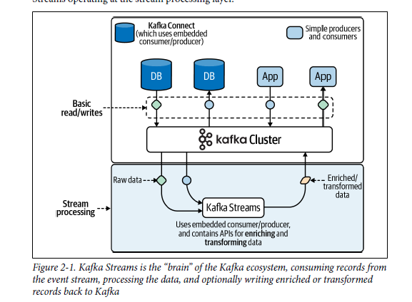
https://www.confluent.io/blog/introducing-kafka-streams-stream-processing-made-simple/

Slide 4
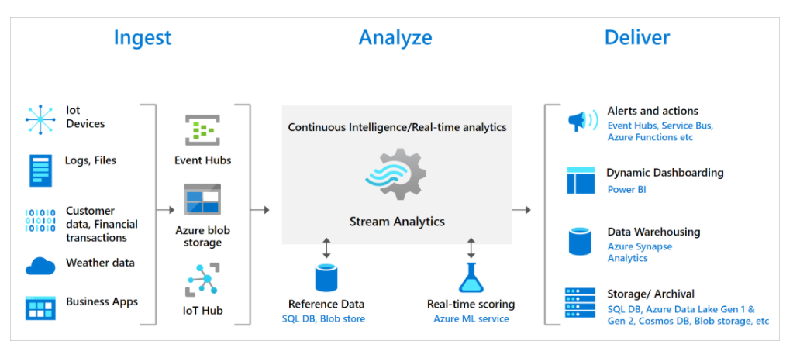
Microsoft option – in case
As a cloud service, Stream Analytics is optimized for cost. There are no upfront costs involved – however you pay for the streaming units you consume. - This can be costly?
https://docs.microsoft.com/en-us/azure/stream-analytics/

